Slide 1
Upscaling TRIO for Student Success: NWCCD’s College Success Program
Joseph Aguirre, Director, College Success Program
Leah A. Barrett, Vice President, Student Affairs
WACCT Conference
11 October 2017

Slide 2
Introductions

Slide 3
Think about the obstacles

Slide 4
Persistence to Completion
Mentoring
As early as possible
Setting and monitoring goals
Commitment/Motivation
Incentives & Scholarships

Slide 5
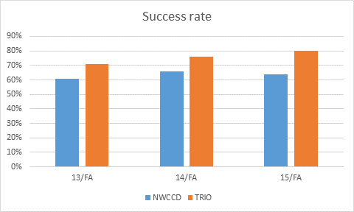
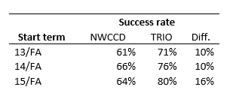
Program outcomes
What is measured
Persistence/Retention
Good standing
Graduation
Transfer
Program success rates

Slide 6
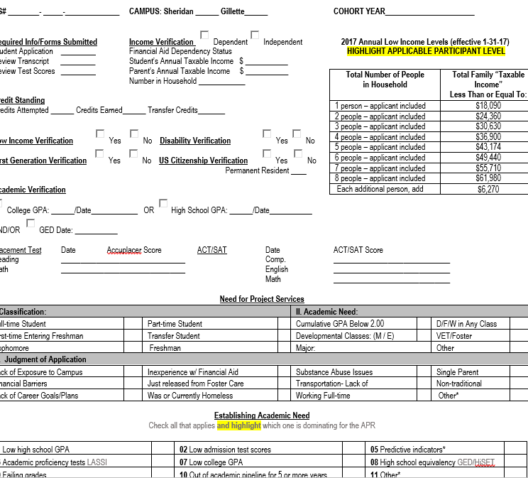
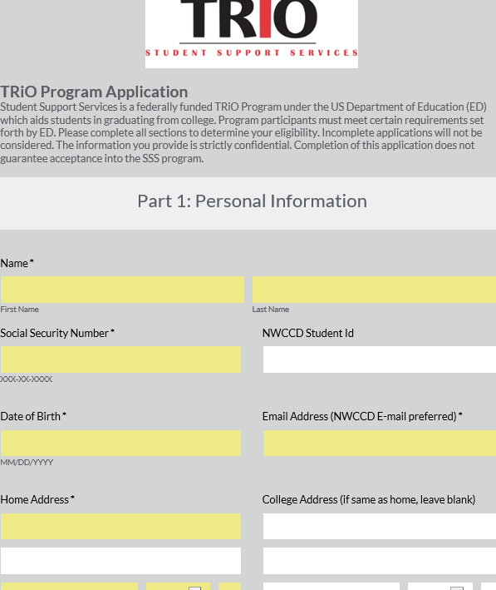
Our Mentoring Model
Staff Structure
Prior
Current
Student caseload management
Application
Intake
Assignment of staff
Intentional intervention
Areas of service
Frequency of contact

Slide 7
Additional Services/Resources
Grant
Cultural enrichment
Career services
Tutoring
Institution
Students served
(Unallowable for grant funds)
Food ☺
Promotional items
Student club activities

Slide 8
QUESTIONS

